Slide 1
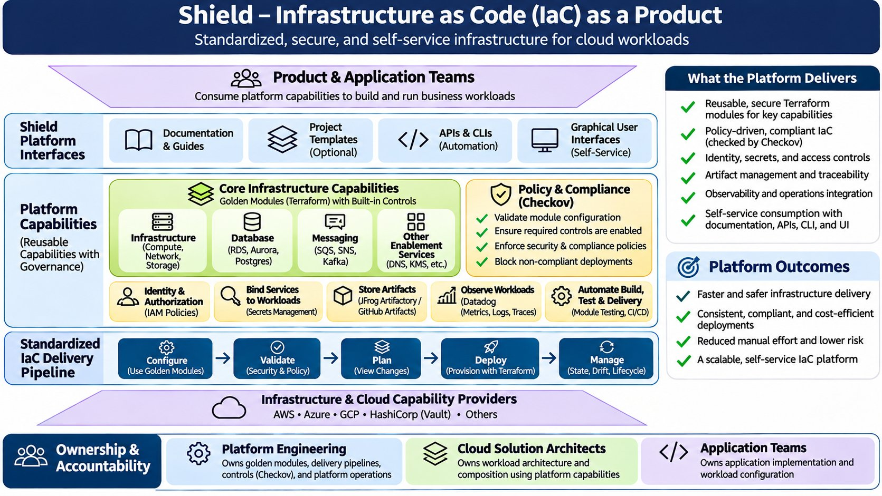
Notes:
Shield – Infrastructure as Code (IaC) as a Product

